Slide 1
Entering Journal Hours into your AET Experiences

Slide 2
Logging in to the recordbook system
Waller School Code: TX0832
Students should already know their Username and password. If they do not, they will need to ask their teacher for this information.
STEP 1

Slide 3
Step 2:
Click on Journal

Slide 4
Click on “Time in your AET Projects / Experiences (SAEs)”
Step: 3

Slide 5
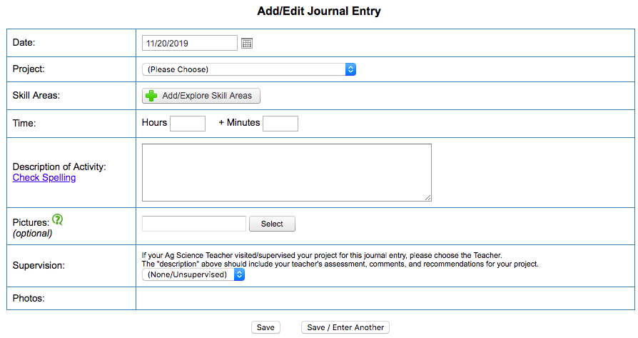
4A: Students need to choose a date that is in the period of their SAE
Step: 4
4B: Students will choose their Project based off of what SAE they are putting this entry in for
4C: Choose two skill areas based off of what type of entry is going in
4D: Students put their time for this activity here. This should be rounded to the nearest hour with no entries over 4 hours
4E: Description of Activity is the most important part. This is the description of the activity (i.e. feeding, washing, walking, …). Make sure to write in complete sentences and use correct grammar.
Nothing in these boxes unless directed by an Ag. Teacher.
4F: Make sure to either click “Save” or “Save / Enter Another” buttons when completed. Failure to do so will result in the journal hour being deleted.

Slide 6
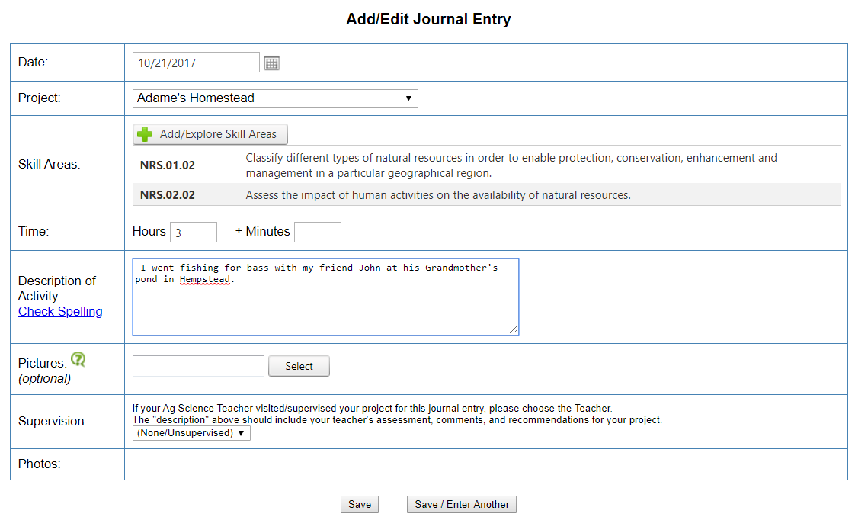
Example of Journal Entry: Fishing

Slide 7
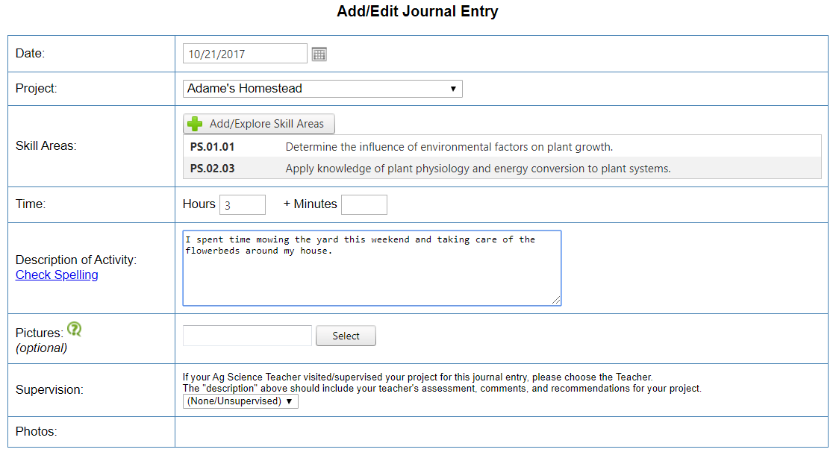
Example of Journal Entry: Mowing

Slide 8
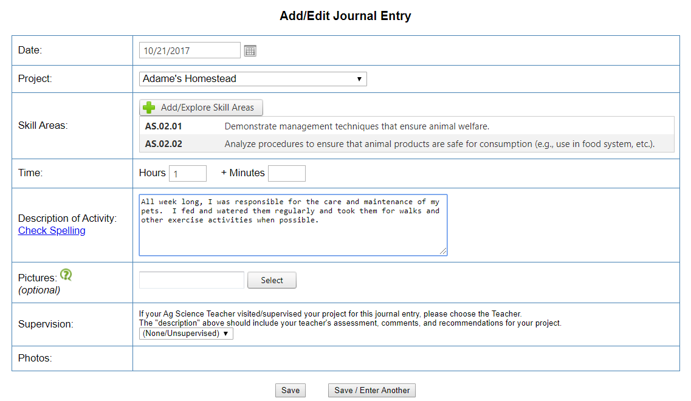
Example of Journal Entry: Caring for Pets

Slide 9
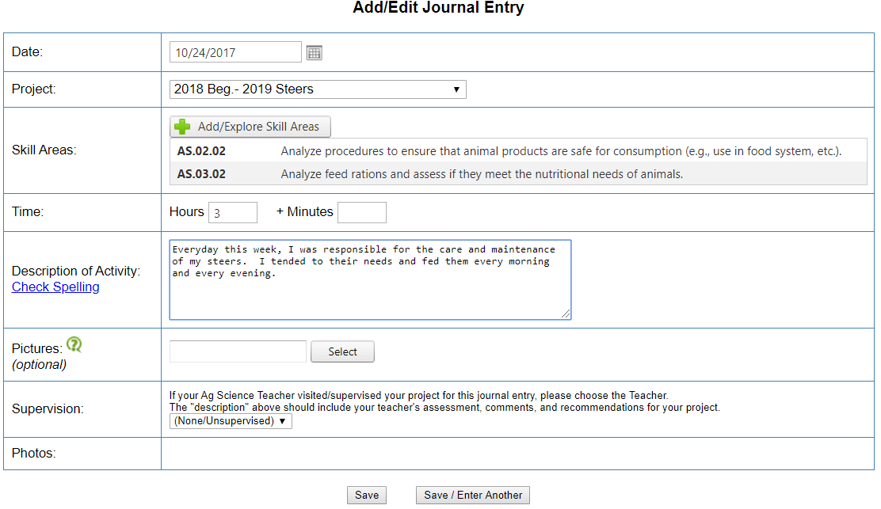
Example of Journal Entry: Maintain Market Project

Slide 10
Examples of Entry Hours:
Homestead SAE | *Mowing the yard *Cleaning up debris around the house *Caring for pets *Fishing *Hunting *Filling feeders *Working with plants / flowers *Grocery Shopping
Steer / Heifer SAEs | *Feeding *Washing *Walking *Setting Up *Veterinary Care *Pen Cleaning
Swine SAEs | *Feeding *Washing *Walking *Veterinary Care *Pen cleaning
Sheep / Goats SAEs | *Feeding *Washing *Walking *Setting Up *Veterinary Car *Pen Cleaning
Poultry SAE | *Feeding *Watering *Pen Cleaning *Culling

Slide 11
Parents wanting to check their students hours can click on “Review your Journal entries” to see all the entries students put in. This is a good place to check and make sure students are tending to their animals and check for grammar.

