Slide 1
WALLER FFA
2023- 2024
Student / Parent
Meeting

Slide 2
WALLER FFA
Welcome
Advisor – Introduction
CTE Coordinator – Introduction
FFA Officer Team

Slide 3
Club Email Address:parentboosterwallerffa@gmail.com
Like us on Facebook & Instagram: parentboosterclubwallerffa
2023-2024 Officers:
President: Missy Owles
1st VP: Linda Randall
2nd VP: Wendy Gitlitz
3rd VP: Kyle Dozier
Secretary: Tina Paliwoda
Treasurer: Mandy Fischer
Parliamentarian: James Capps

Slide 4
PARENT BOOSTER CLUB – WALLER FFA
Who are we?
Parents of FFA students that want to see ALL the kids succeed.
What do we do?
Volunteer a fraction of our time to support Waller FFA.
Raise money for scholarships to benefit outgoing seniors.
Provide support and extra assistance to the chapter, teachers and kids.
Support chapter with any needs and extra expenses:
State Convention support and travel
Washington Leadership Conference support and travel
Necessary equipment and resources

Slide 5
PARENT BOOSTER CLUB – WALLER FFA
When do we meet?
Alongside student FFA Chapter Meetings ~ 6:00pm
Where do we meet?
At Waller HS
Why do we exist?
To maximize the student’s opportunities and readiness in preparing for society.
To be an additional and positive resource to FFA teachers and Waller HS administrators.

Slide 6
2022- 2023 FUNDRAISING
to Waller FFA Chapter
State Convention Travel
LDE & CDE Teams
$40,000 In Fundraising
recipients and parents time & hard work invested paid off
Advice: Know the requirements and work towards them

Slide 7
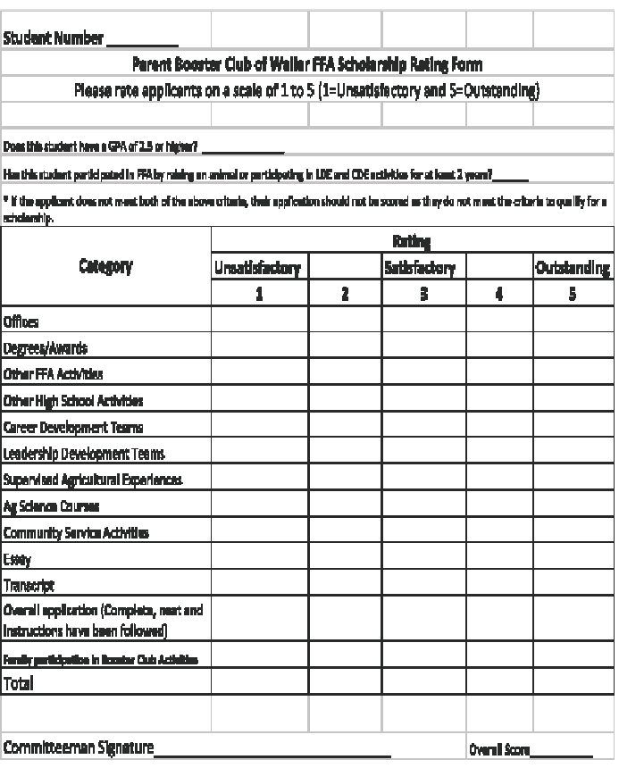
BOOSTER CLUB SCHOLARSHIP JUDGING
Factors Judged for Scholarship:
Grades
Participation
Projects
LDE & CDE Involvement
Degrees, Awards, & Activities
Essay
Family participation with Booster Club
Exceptions for extenuating circumstances

Slide 8
Waller FFA Parent Booster Club Winter Blowout

Slide 9
READY TO GET STARTED?
Become a member tonight! Sign up after meeting in the back.
Prepare to serve in fundraisers:
Waller ISD is exploding!
Need your new ideas and involvement to keep up with growth.

Slide 10
DUES
Booster Club Membership $25 per family
Fill out appropriate form- Payments must be separate.
Forms can also be found on the FFA website under the booster club tab.

Slide 11
How do you become a FFA/Jr. FFA Member?
You must be enrolled in an Ag. Class at Waller High School or Jr. FFA member must be enrolled in a Waller ISD School 3rd-8th grade.
Pay your yearly membership dues on September 25th.

Slide 12
WEBSITE
https://waller.ffanow.org
You need to register your email in order to receive emails from us.
You will also find our calendar, documents and forms

Slide 13
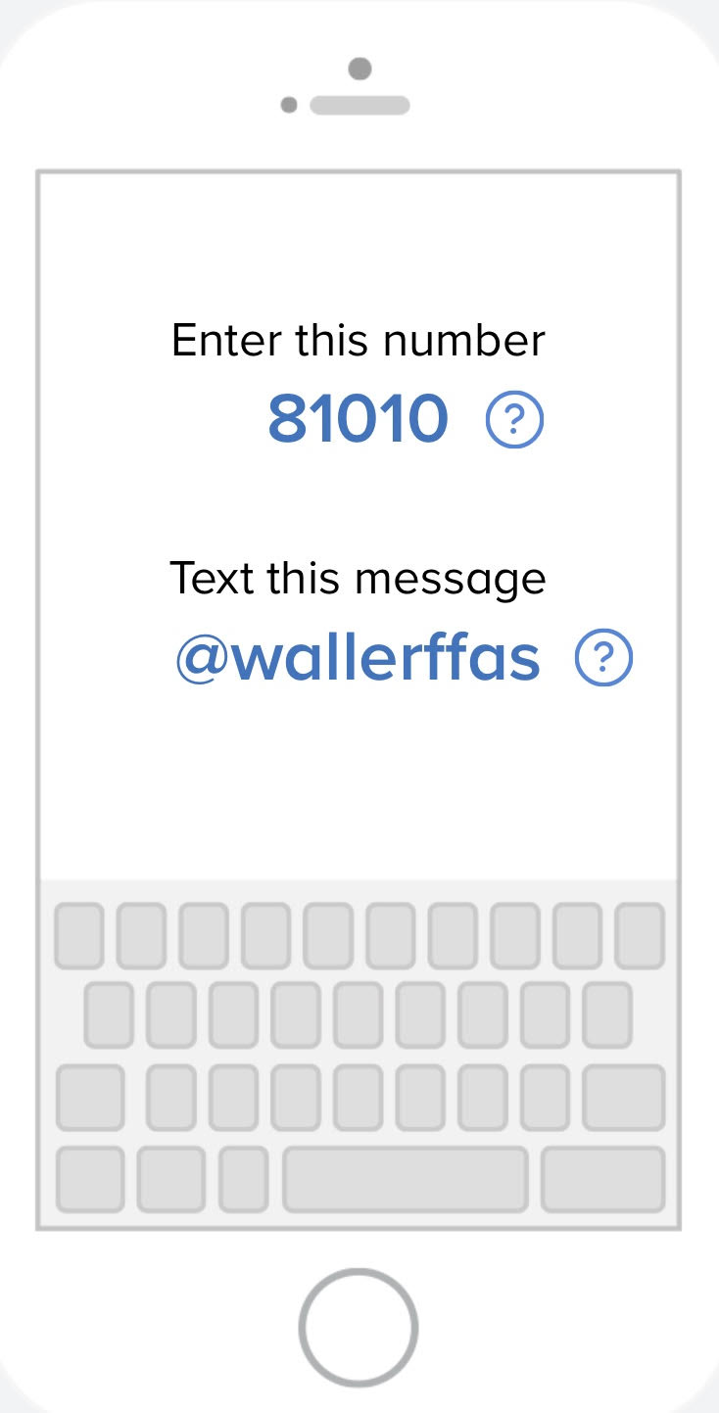
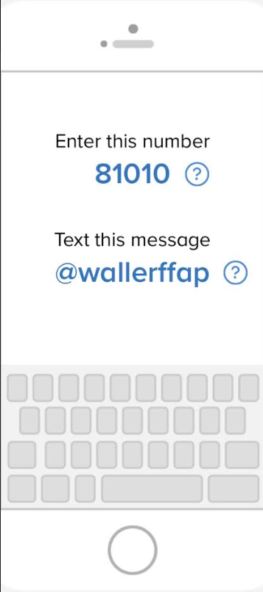
FFA REMIND
STUDENTS
PARENTS

Slide 14
Waller FFA
Signed Forms
Membership Roster Form - FILL OUT EVERY BLANK.
Waller FFA & Jr. FFA Membership & Rules Acknowledgment Form
Waller Independent School District Rules Acceptance Form for FFA Show - If showing at the FFA Show
Waller County Fair Eligibility Form (9/25/23)
On Waller FFA website under waller county fair tab
Random Drug Testing Form - ALL FFA MEMBERS MUST SIGN THIS FORM!!!!! (HS)
ALL FORMS ARE DUE BY September 25th!

Slide 15
PAYMENT NIGHT
We will be hosting payment night this year from 4pm-7pm on Monday, September 25th in the Ag. Building.
What is the purpose of payment night?
A way to consolidate all FFA related expenses into one payment time and location. This allows us to more efficiently and accurately collect payments.
What will be paid for at payment night?
FFA/Jr. FFA Dues ($50)
FFA T-Shirts ($20) for any additional T-Shirt
FFA Jackets ($60-$85)
Ag Course Fee’s (Floral $50)

Slide 16
MONTHLY MEETINGS
Payment Night September 25th
October 9th
November 13th
December 11th
February 5th
March 4th
April 8th
May 13th (Awards Night) @ 5PM
All dates can be found on the Waller FFA Website!!

Slide 17
MONTHLY MEETINGS
FFA Members & Jr FFA Members meet at 6:00 pm in the SMALL cafeteria.
Attendance will be taken.

Slide 18
WALLER FFA Awards Night
FFA Awards Night
Spring awards night held on May 13th @ 5:30pm in the auditorium.

Slide 19
WALLER COUNTY FAIR
Clipping for Waller County Show
Cattle, Sheep, and Goats will be clipped/sheared at the Waller High School Ag barn Facilities.
Swine can be clipped at the student's residence if conducive to clipping. Otherwise, they will be clipped at the school ag barn.
Clipping will take place the week prior to fair from Monday to Thursday.
Please email the corresponding ag teacher who is over your specific specie to set up a time or ask for assistance.
jdiiorio@wallerisd.net - Cattle
cleblanc@wallerisd.net - Sheep, Goats and Poultry
kbarkley@wallerisd.net - Swine, Rabbits
rstokley@wallerisd.net - Livestock Supervisor

Slide 20
Waller County Fair Show Dates
Lambs, Goats & Does - Monday, 10/2/23
Rabbits - Tuesday, 10/3/23
Broilers & Turkeys - Wednesday, 10/4/23
Swine - Wednesday, 10/4/23
Cattle - Thursday, 10/5/23
Livestock Judging Contest - Friday 10/6/23
Sale - Saturday - 10/7/23

Slide 21
WCFA Exhibitor Signs
If you are exhibiting a project you need to go to our FFA website to sign-up for how many exhibitor signs you need. This is under the Exhibitor Signs for Fair Tab. If you do not do this by Sept. 14th you will not have a sign for the fair.
We will also use this list to make our excusal list for attendance. Make sure you fill this out ASAP.
Poultry Exhibitors - Holders need to be named by the 14th also on the same list.
Holders must be a member of Waller FFA.
https://waller.ffanow.org

Slide 22
WALLER COUNTY FAIR
Set Up
Sunday, October 1st ONLY. No setup on Monday
Cattle stalls will ONLY be allowed pelleted bedding
Pelleted bedding must be bought from the fair and will be delivered to your stall.
Spots will be first come first served after 8:00 AM
Mr. DiIorio will be there from 8 -12 on Sunday with exhibitor signs.
Bring all tack needed
Tear Down:
Sunday, October 8th
Make sure you have a stamped envelope to give to the committee for Thank-You notes.
Signs need to be given back to the Ag Teacher even if you're a senior. Sign at Awards Night.

Slide 24
AG SHOW RULE
The sale is based on selling a maximum of 84 lots
Two lots in the auction will be for the Best of Show Agriculture Mechanics and Horticulture.
All Grand and Reserve animals and Best of Show Projects must sell.
A student may only auction one livestock project unless he/she earns Grand or Reserve with two or more different species.
A student may auction one livestock project and Best of Show(s).
All exhibitors will pay a commission of 6% (.06) on all sale items, including Best of Shows, add-ons, and silent auction items.

Slide 25
AG SHOW RULE CHANGES
There is no more lotto system for selection. You may buy your project from any breeder of your choosing. If you need help finding an animal we will be happy to help you.
Students are allowed to show in proper show clothes. Button up collared shirt, jeans with no holes and leather shoes or boots.

Slide 26
AG SHOW RULE CHANGES CONT.
Jr. Breeding Heifer:
1. Heifers that are shown in the Commercial Heifer Show are not eligible to show in the Jr.
Breeding Heifer show.
2. Must be validated for Texas Majors under exhibitor name.
3. Jr. Breeding Heifers will NOT be eligible for auction.
4. Registration papers are required at check-in.
5. Entry Fee of $50 is due November 27th at tag-in.
6. This will be a blow and go show only, no adhesives, paints, oils etc. are permissible.

Slide 27
AG SHOW RULE CHANGES CONT.
Ag Mech/Horticulture
ONE project will be sold per exhibitor, in either the live auction or silent auction.
Example: You can sell a 2nd place pig and Best of Show or Silent Auction project.
Horticulture: Texas Tables Category
If you need to purchase flowers see Mrs. Barkley

Slide 28
FFA OFFICIAL DRESS
Official Dress
Must have to be eligible to auction in Waller FFA Show
Two Types
Auction Official Dress
FFA Jacket, White button down, FFA tie/scarf, BLACK slacks/black jeans, SOLID BLACK boots/black shoes
BUSINESS Official Dress (Banquets, LDE Contests, Etc.)
FFA Jacket, White button down, FFA tie/scarf, BLACK slacks/black jeans for GUYS, Black knee length skirt for GIRLS, and SOLID BLACK boots/black shoes for GUYS, SOLID BLACK heels for GIRLS

Slide 29
MAJOR SHOWS ENTRY NIGHT
Thursday, November 2nd
4:00 - 6:00 P.M.
Waller Ag. Building

Slide 30
MAJOR SHOW VALIDATION
Major Swine Tags
Ordering swine tags by TBA
Heifers: October 24th @ Royal ISD Barn 4-6PM
Sheep & Goats: October 24th @ Royal ISD Barn 4-6PM
Swine Validation: TBA, Committee will come by your house to tag hogs.

Slide 31
BROILERS
Broiler orders for the Texas Majors will take place tonight.
Broiler orders for the Waller FFA Ag Show must be submitted and paid for by November 2nd, 2023. No Exceptions
All broilers must be ordered in increments of 25
You must order a minimum of 25 chicks
The maximum number of chicks you may order is 75
Broiler cost per chick:
Major Broilers: $1.50/chick
Ag Show Broilers: $1.62/chick

Slide 32
Fundraising
Seitz
Starting date will be on September 25th
If showing in ag show and/or chapter officers, must sale $250 worth of product.
We will be selling Meats, Gifts and Cookies
Due Date (all payments and all order forms): October 7th.
Delivery Date: TBD but will be before Thanksgiving

Slide 33
FRIENDLY REMINDERS
ALL PAYMENTS AND FORMS WILL BE TURNED IN ON PAYMENT NIGHT ON Sept. 25th 4-7pm IN THE AG BUILDING
Future Dates:
Major Show Entries: Nov. 2nd at the Ag. Building from 4-6pm
Animal Tag-In for all species for the Ag Show Nov.27th W.C.F. From 4-6pm
District LDE’s: November 10th
Area LDE’s: November 18th
Ag Show Progress Show February 6th
Waller FFA Ag Show: March 26th-28th
Waller FFA Ag Show Set Up: March 25th
Spring Awards Night: May 13th

Slide 34
LDE Teams
Practices are starting very soon! Watch out for communication about practices on Remind.
Team | Coach
Chapter Conducting (GH & SR) | Mrs. Barkley (practice this week! Tuesday & Thursday, 3-4)
Job Interview | Mrs. Barkley
Ag Advocacy | Mr. DiIorio
Radio | Mr. DiIorio
Ag Issues | Mr. Leblanc
Skills (GH & SR) | Mr. Leblanc
Creed Speaking (GH & SR) | Mr. Stokley
FFA Quiz (GH & SR) | Mr. Stokley

Slide 35
Barnyard Buddies
Paid FFA Membership (required)
When? October 4th
Where? Waller County Fairgrounds
Permission Slips
Must be turned into Mr. Leblanc by September 21st in order to go.
Poultry exhibitors, holders and hog exhibitors are not allowed to participate.

Slide 36
Community Service
This Month: School Supply Drive
Donate by 27th
Top 15 Donors will receive a Pizza Party!
Make sure you donate to an ag teacher so we can count it.
Month | Service
September | School Supply Drive - Waller ISD Elementaries
October | Trunk-or-Treat
November | Canned Food Drive
December | Angel Tree & Wreaths Across America

Slide 37
ARE THERE ANY QUESTIONS?

Slide 38
FFA REMIND
STUDENTS
PARENTS

