Slide 1
WALLER FFA
2024- 2025
Student / Parent
Meeting

Slide 2
WALLER FFA
Welcome
Advisor – Introduction
CTE Coordinator – Introduction
FFA Officer Team

Slide 5
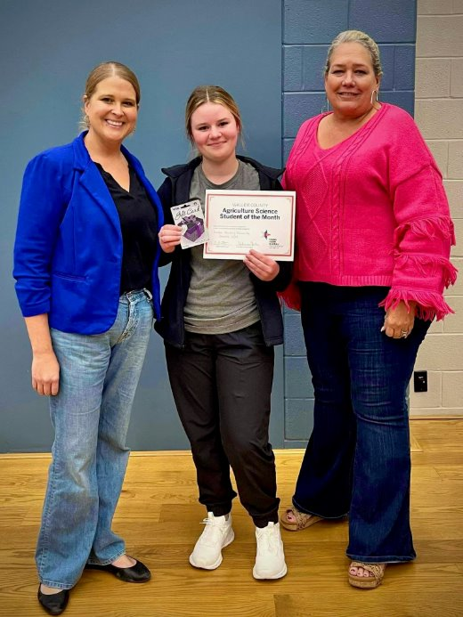
2024 Scholarship Winner
Brooke Harding!​

Slide 6
Scholarship Application

Slide 7
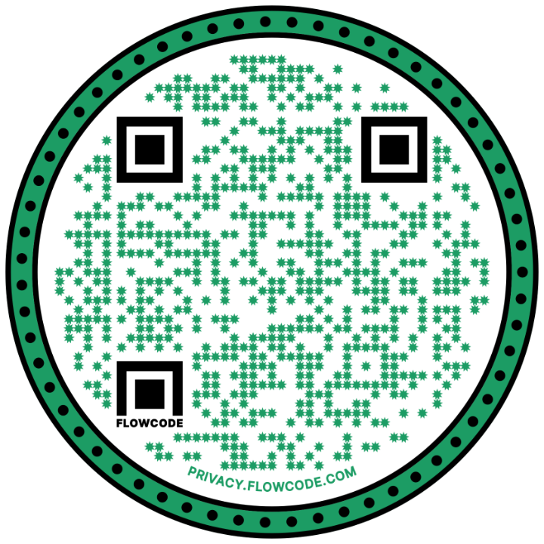
Ambassador Program

Slide 8
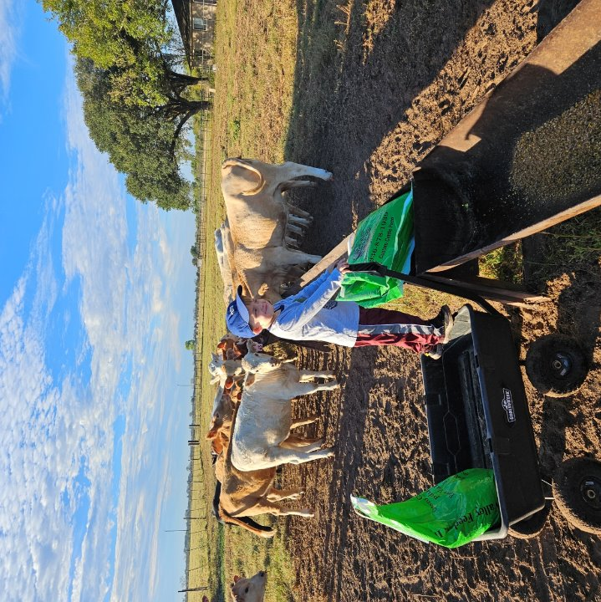

Slide 9
**NEW** Office Location!
2313 Main St, Waller, TX 77484​
*previously Wells Fargo bank*​

Slide 10
Club Email Address:parentboosterwallerffa@gmail.com
Like us on Facebook & Instagram: parentboosterclubwallerffa
2024-2025 Officers:
President: Kyle Dozier
1st VP: Wendy Gitlitz
2nd VP: Trevette Bookman
3rd VP: Natalie Lynch
Secretary: Monica Wilson
Treasurer: Megan Linton
Parliamentarian: Anna Vance

Slide 11
PARENT BOOSTER CLUB – WALLER FFA
When do we meet?
Alongside student FFA Chapter Meetings ~ 6:00pm
Where do we meet?
At Waller HS
Why do we exist?
To maximize the student’s opportunities and readiness in preparing for society.
To be an additional and positive resource to FFA teachers and Waller HS administrators.

Slide 12
How do you become a FFA/Jr. FFA Member?
You must be enrolled in an Ag. Class at Waller High School or Jr. FFA member must be enrolled in a Waller ISD School 3rd- 7th grade.
Pay your yearly membership dues on September 25th.

Slide 13
WEBSITE
https://waller.ffanow.org
You need to register your email in order to receive emails from us.
You will also find our calendar, documents and forms

Slide 14
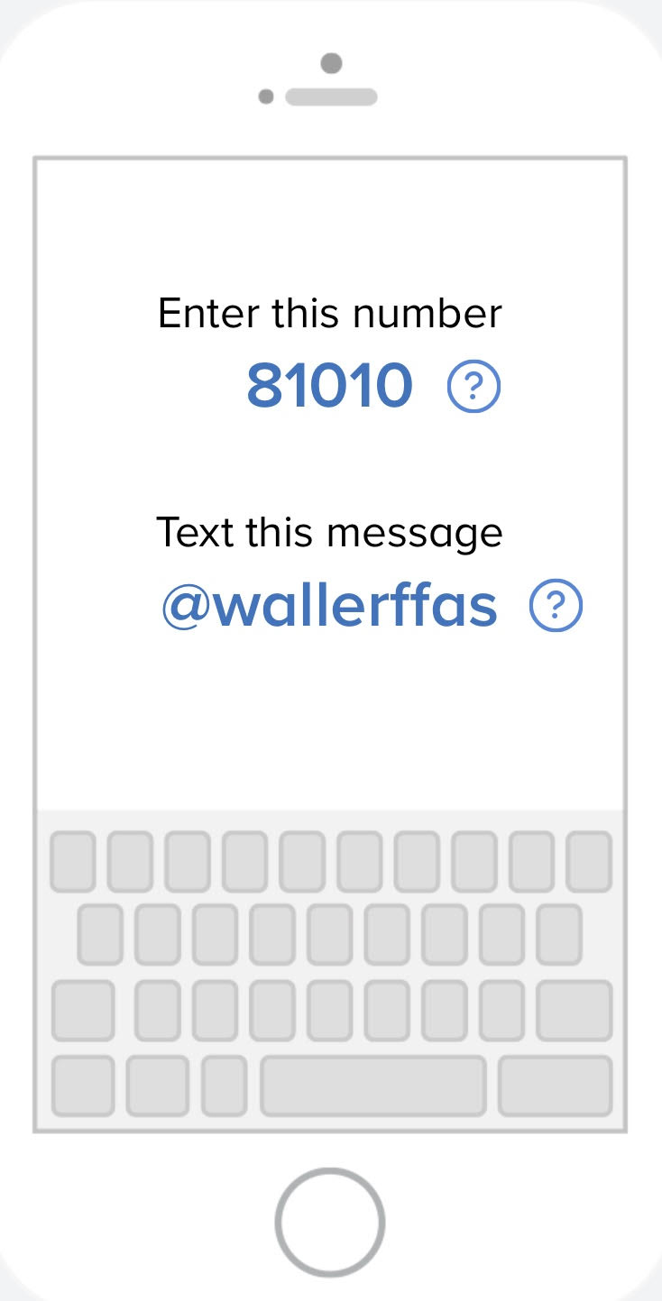
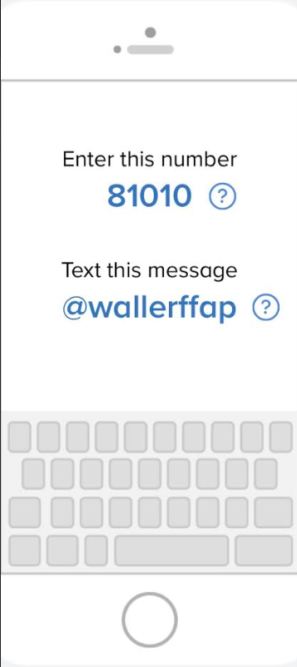
FFA REMIND
STUDENTS
PARENTS

Slide 15
PAYMENT NIGHT
We will be hosting payment night this year from 4pm-6pm on Monday, September 23rd in the Ag. Building.
What is the purpose of payment night?
A way to consolidate all FFA related expenses into one payment time and location. This allows us to more efficiently and accurately collect payments.
What will be paid for at payment night?
FFA/Jr. FFA Dues ($60)
FFA T-Shirts ($20) for any additional T-Shirt
FFA Jackets ($55-$80)
Ag Course Fee’s (Floral $50)

Slide 16
Waller FFA
Required Membership Forms
Membership Roster Form - FILL OUT EVERY BLANK.
Waller FFA & Jr. FFA Membership & Rules Acknowledgment Form
Waller Independent School District Rules Acceptance Form for FFA Show - If showing at the FFA Show
Waller County Fair Eligibility Form (9/23/24)
On Waller FFA website under waller county fair tab
Random Drug Testing Form - ALL FFA MEMBERS MUST SIGN THIS FORM!!!!! (HS)
ALL FORMS ARE DUE BY September 23rd!!

Slide 17
MONTHLY MEETINGS
Payment Night September 23rd
October 14th
November 11th
December 9th
January 13th
February 3rd
April 7th
May 12th (Awards Night) @ 5:30PM
All dates can be found on the Waller FFA Website!!

Slide 18
MONTHLY MEETINGS
FFA Members & Jr FFA Members meet at 6:00 pm in the SMALL cafeteria.
Attendance will be taken.

Slide 19
LDE Teams
Practices are starting very soon! Watch out for communication about practices on Remind.
Team | Coach
Chapter Conducting (GH & SR) | Mrs. Barkley (practice this week! Tuesday & Thursday, 3-4)
Job Interview | Mrs. Barkley
Ag Advocacy | Mr. DiIorio
Radio | Mr. DiIorio
Ag Issues | Mr. Leblanc
Skills (GH & SR) | Ms. Cegelski (GH) & Mr. Leblanc (SR)
Creed Speaking (GH & SR) | Ms. Cegelski (GH) & Mr. Stokley (SR)
FFA Quiz (GH & SR) | Ms. Cegelski (GH) & Mr. Stokley (SR)

Slide 20
WALLER COUNTY FAIR
Clipping for Waller County Show
Cattle, Sheep, and Goats will be clipped/sheared at the Waller High School Ag barn Facilities.
Swine can be clipped at the student's residence if conducive to clipping. Otherwise, they will be clipped at the school ag barn.
Clipping will take place the week prior to fair from Monday to Thursday.
Please email the corresponding ag teacher who is over your specific specie to set up a time or ask for assistance.
jdiiorio@wallerisd.net - Cattle
cleblanc@wallerisd.net - Sheep & Goats
kbarkley@wallerisd.net - Swine, Rabbits
mcegelski@wallerisd.net - Poultry
rstokley@wallerisd.net - Livestock Supervisor

Slide 21
Waller County Fair Show Dates
Lambs, Goats & Does - Monday, 9/30/24
Rabbits - Tuesday, 10/1/24
Broilers & Turkeys - Wednesday, 10/2/24
Swine - Wednesday, 10/2/24
Cattle - Thursday, 10/3/24
Livestock Judging Contest - Friday 10/4/24
Sale - Saturday - 10/5/24

Slide 22
WCFA Exhibitor Signs
If you are exhibiting a project you need to go to our FFA website to sign-up for how many exhibitor signs you need. This is under the Exhibitor Signs for Fair Tab. If you do not do this by Sept. 12th you will not have a sign for the fair.
We will also use this list to make our excusal list for attendance. Make sure you fill this out ASAP.
Poultry Exhibitors - Holders need to be named by the 12th also on the same list.
Holders must be a member of Waller FFA.
https://waller.ffanow.org

Slide 23
WALLER COUNTY FAIR
Set Up
Sunday, September 29th ONLY. No setup on Monday
Cattle stalls will ONLY be allowed pelleted bedding
Pelleted bedding must be bought from the fair and will be delivered to your stall.
Spots will be first come first served after 8:00 AM
Mr. DiIorio and Mr. LeBlanc will be there from 8 -12 on Sunday with exhibitor signs.
Bring all tack needed
Tear Down:
Sunday, October 6th
Make sure you have a stamped envelope to give to the committee for Thank-You notes.
Signs need to be given back to the Ag Teacher even if you're a senior. Sign at Awards Night.

Slide 25
AG SHOW RULEs
All Grand and Reserve animals and Best of Show Projects must sell.
A student may auction one livestock project and Best of Show(s) or Blue Ribbon Project.
A student may only auction one livestock project unless he/she earns Grand or Reserve with two or more different species.
All exhibitors will pay a commission of 6% (.06) on all sale items, including Best of Shows, add-ons, and silent auction items.

Slide 26
AG SHOW RULE CHANGES
2025 Waller FFA Ag Show will be in held in the new Ag Science Facility (Back up location Waller County Fairgrounds)
8th grade students enrolled in Principles of Ag are eligible to exhibit at the Waller ISD FFA Show
Ag Show is now a terminal show. All animals sold in the auction other than commercial heifers will be processed. Buyers will not have the option to donate animals back to the chapter and/or student.
Non-sale animals that you would like to floor must be floored 30 minutes after the conclusion of the heifer show.
All Blue Ribbon projects (Horticulture/Ag Mech) are eligible to sell in the live auction

Slide 27
FFA Auction OFFICIAL DRESS
Must have to be eligible to auction in Waller FFA Show
Auction Official Dress
FFA Jacket, White button down, FFA tie/scarf, BLACK slacks/black jeans, SOLID BLACK boots/black shoes

Slide 28
MAJOR SHOWS ENTRY NIGHT
Monday October 28, 2024
4:00 - 6:00 P.M.
Waller Ag. Building

Slide 29
MAJOR SHOW VALIDATION
Major Swine Tags
Order Major Swine Tags with Mrs. Barkley by September 18th! $15/each
Heifers: October (Date/ Time TBD) @ Royal ISD Barn
Sheep & Goats: (Date/Time TBD) @ Royal ISD Barn
Swine Validation: TBA, Committee will come by your house to tag hogs.

Slide 30
BROILERS
Broiler orders for the Texas Majors and Waller ISD Ag Show will take place tonight. Please see Ms. Cegelski and Mr. LeBlanc after the meeting to get your order placed.
If you do not have payment tonight, still place your order, payments MUST be turned in by this Thursday 9/12!
All broilers must be ordered in increments of 25
You must order a minimum of 25 chicks
The maximum number of chicks you may order is 75
Broiler cost per chick:
Major show birds $1.50 per chick
Ag Show birds $1.74 per chick

Slide 31
Fundraising
Seitz
Starting date will be on September 23rd
If showing in ag show and/or chapter officers, must sell $250 worth of product.
We will be selling Meats, Gifts and Cookies
Due Date (all payments and all order forms): October 7th.
Delivery Date: TBD but will be before Thanksgiving

Slide 32
FRIENDLY REMINDERS
ALL PAYMENTS AND FORMS WILL BE TURNED IN ON PAYMENT NIGHT ON Sept. 23rd 4-6pm IN THE AG BUILDING
Future Dates:
Major Show Entries: Oct. 28th at the Ag. Building from 4-6pm
District LDE’s: November 15th
Area LDE’s: November 23rd
Animal Tag-In for all species for the Ag Show Dec. 2nd W.C.F. From 4-6pm
Ag Show Progress Show January 6th
Waller FFA Ag Show: February 25th-28th
Waller FFA Ag Show Set Up: March 24th
Spring Awards Night: May 12th

Slide 33
Barnyard Buddies
Paid FFA Membership (required)
When? October 2nd
Where? Waller County Fairgrounds
Permission Slips
Must be turned into Mr. Leblanc by September 16th in order to go.
Poultry exhibitors, holders and hog exhibitors are not allowed to participate.

Slide 34
ARE THERE ANY QUESTIONS?

